Slide 1
Electrical Power System with Maximum Power Point Tracking (MMPT)
Lead Engineer: Elijah Gibbs
Manager: Jeffrey Kruth
Technical Advisor: Nate Fite

Slide 2
Project Description
Build an EPS that:
Generates power from solar array
Utilizes a MPPT structure to allow for maximum power to be gathered
Regulates power going in and out of the batteries
Takes power from batteries and regulates it to a 3.3V regulated line and 5V regulated line.
Ensures power is distributable to multiple other systems
Will have onboard microcontroller to control and monitor EPS with sensors

Slide 3
Why am I qualified to do this?
Applicable Experience:
Worked as Embedded HW Engineer Intern over the summer
Have enhanced my knowledge in electrical systems
Have enhanced my knowledge in software systems
Education:
Space Systems Engineering
Gained a fundamental understanding of electrical systems within the context of space technology.
Through classes such as: Circuits, Spacecraft Electronic Systems, RF Transmission Lines & Circ.
Minor in Computer Science:
Gained hands-on experience in coding, software design, and problem-solving.
Overall:
With all these areas combined I have acquired a well-rounded skill set capable of taking on the challenges of this project.
Notes:
Mention Classes

Slide 4
Resources
Parts: Suppliers like DigiKey, Mouser Electronics, and free sampling from Coilcraft, KEMET, STmicro, TI, and Rogers.
Software: LTspice (circuit simulation), draw.io (circuit and block diagram design), Fusion 360 (3D modeling), Altium (PCB design), C and Python (programming).
Tools: Soldering iron, oscilloscope, multimeter, current supply, and general electric items (available in SSC labs).

Slide 5
Timeline / Endpoint
Current estimate for time to complete is at roughly 240 hours.
Includes time for:
Research(32 hours): 13.3% of remaining time
Design(40 hours): 16.7% of remaining time
Implementation(50 hours): 20.8% of remaining time
Testing (50 hours): 20.8% of remaining time
Iteration (20 hours): 8.3% of remaining time
Documentation (48 hours): 20.0% of remaining time
Endpoint :
The endpoint of this project is to be a functional brass board and PCB design.

Slide 6

Questions?

Slide 7
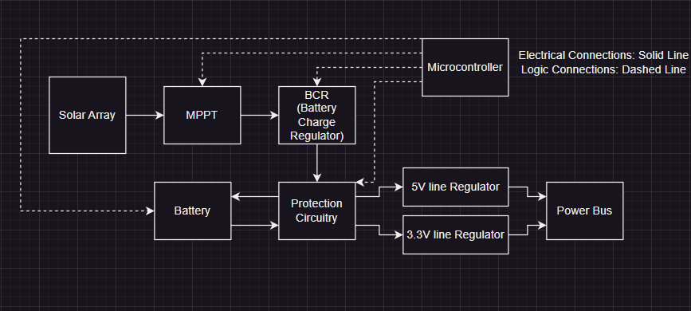
System Level Design

